Slide 1
CS3205 – HCI in Software Development Heuristic Evaluations
Dr. Mark Floryan
Rice Hall 203
mrf8t@cs.virginia.edu

Slide 2
Topics
Heuristic Evaluations– What are they?
Concrete Example –
Using researchers (you!) to study mental health apps
Research Question
Research Design
Model for heuristic evaluation
Following the Model – An Example
HW – You will go and finish this experiment
Notes:
Quickly discuss how we did a lit. review and came up with five gamification principles. Don’t discuss each of them yet, there is a slide for each coming up.

Slide 3
Heuristic Evaluations
Notes:
Quickly discuss how we did a lit. review and came up with five gamification principles. Don’t discuss each of them yet, there is a slide for each coming up.

Slide 4
Heuristic Evaluations
A Heuristic Evaluation involves having a small set of evaluators examine the interface and judge its compliance with recognized usability principles (the “heuristics”).
*(Nielsen, 1994)
Notes:
Quickly discuss how we did a lit. review and came up with five gamification principles. Don’t discuss each of them yet, there is a slide for each coming up.

Slide 5
Heuristic Evaluations
Some questions about Heuristic Evaluations:
How “expert” do the evaluators need to be?
How many evaluators are required?
What are the heuristics?
Notes:
Quickly discuss how we did a lit. review and came up with five gamification principles. Don’t discuss each of them yet, there is a slide for each coming up.

Slide 6
Heuristic Evaluations
How many evaluators are required? (Nielsen, 1992)
Result: Use at least 3 to 5 investigators. Diminishing returns after this.
Notes:
Quickly discuss how we did a lit. review and came up with five gamification principles. Don’t discuss each of them yet, there is a slide for each coming up.

Slide 7
Heuristic Evaluations
How many evaluators are required? (Nielsen, 1993)
Result:
ProblemsFound(i) = N(1 – (1-L)^{i})
**L ranges from 19% - 51%. Mean = 34%
**N ranges from 16 - 50. Mean = 33
Notes:
Quickly discuss how we did a lit. review and came up with five gamification principles. Don’t discuss each of them yet, there is a slide for each coming up.

Slide 8
Heuristic Evaluations
Do a Cost-Benefit Analysis!
Assumptions / Example:
COST:
Company has $4,000 for general costs plus $600 per expert
cost(i) = $(4000 + 600i)
BENEFIT:
Estimate each problem worth $15,000 to save from going out into production.
Ratio(i,n)
= 15,000*n / (4000 + 600i)
^^ Sample result of cost-benefit analysis. Curve typically has this shape.
Notes:
Quickly discuss how we did a lit. review and came up with five gamification principles. Don’t discuss each of them yet, there is a slide for each coming up.

Slide 9
Heuristic Evaluations
Procedure for a Heuristic Evaluation:
Experts analyze the interface alone with little to no prior guidance
WHY: Don’t bias the expert before they begin or teach them anything they wouldn’t otherwise realize.
Experts all finish independent analyses before they are allowed to communicate with each other or aggregate.
WHY: Experts can bias each other’s opinion before evaluation begins.
Designer should be present with expert, but only communicate with them when necessary or prompted.
WHY: Want expert’s raw opinion / interaction, but might need to intervene if confusion arises, bug in interface, expert has questions, etc.
Notes:
Quickly discuss how we did a lit. review and came up with five gamification principles. Don’t discuss each of them yet, there is a slide for each coming up.

Slide 10
Heuristic Evaluations
What are the heuristics here?
Designer / Experimenter
observes
communicates with
Wizard’s Smokescreen
Expert
Interface
Wizard
(Optional)
interacts
feedback
controls
receives input from
has studied / understands
implements
Heuristics
e.g., design principles
e.g., some other model
Notes:
Quickly discuss how we did a lit. review and came up with five gamification principles. Don’t discuss each of them yet, there is a slide for each coming up.

Slide 11
Heuristic Evaluations
What are the heuristics here?
Heuristics
e.g., design principles
e.g., some other model
How do we develop this model?
Use a well-known set of principles (e.g., design principles from class)
Develop your own model related to the domain of interest
Do heuristic evaluations and use expert comments to build a set of principles for future tests.
Notes:
Quickly discuss how we did a lit. review and came up with five gamification principles. Don’t discuss each of them yet, there is a slide for each coming up.

Slide 12
Heuristic Evaluations
What are the heuristics here?
Heuristics
e.g., design principles
e.g., some other model
Even for experts, it is tempting to say “I just don’t like this feature” or “It just doesn’t feel right”.
The expert needs to be encouraged to precisely describe why a feature of the interface does not conform to the principles OR address why the principles are flawed.
Notes:
Quickly discuss how we did a lit. review and came up with five gamification principles. Don’t discuss each of them yet, there is a slide for each coming up.

Slide 13
Concrete Example – Studying Mental Health Apps
Notes:
Quickly discuss how we did a lit. review and came up with five gamification principles. Don’t discuss each of them yet, there is a slide for each coming up.

Slide 14
Concrete Example – Studying Mental Health Apps
Center for Behavioral Health Technology @ UVa
Study e-health – technology for enhancing physical and mental well-being.
Includes:
Fitness applications
Insomnia prevention
Depression
Mobile applications
Wearable devices
Etc.
They have a research question for us, and you are going to help us with it:
Mental health applications are really into gamification right now. Does it actually work?
Notes:
Quickly discuss how we did a lit. review and came up with five gamification principles. Don’t discuss each of them yet, there is a slide for each coming up.

Slide 15
Example: Internet Interventions
Mental health applications are really into gamification right now. Does it actually work?
Process for answering this question using a heuristic evaluation:
Define a model: a set of heuristics for the domain in question. Notice that we won’t know 100% that our heuristics are valid. It is a hypothesis.
Study the model: so we understand its components and can act as experts in evaluating some apps.
Evaluate Apps: Use some mental health apps and do an evaluation of how they conform to our model.
Validate: See if our model / evaluations correlate to the efficacy of the individual apps. Do apps that conform to our model work better?
**#1 done in lecture, #2 and #3 are your HW, #4 I will do to see what we find.
Notes:
Quickly discuss how we did a lit. review and came up with five gamification principles. Don’t discuss each of them yet, there is a slide for each coming up.

Slide 16
1: Define a Model
Supporting Player Archetypes
Meaningful Choice
Meaningful Purpose
Feedback
Visibility of Progress
*NOTE: We are not claiming these are exhaustive or complete. They are heuristics.
Notes:
Quickly discuss how we did a lit. review and came up with five gamification principles. Don’t discuss each of them yet, there is a slide for each coming up.

Slide 17
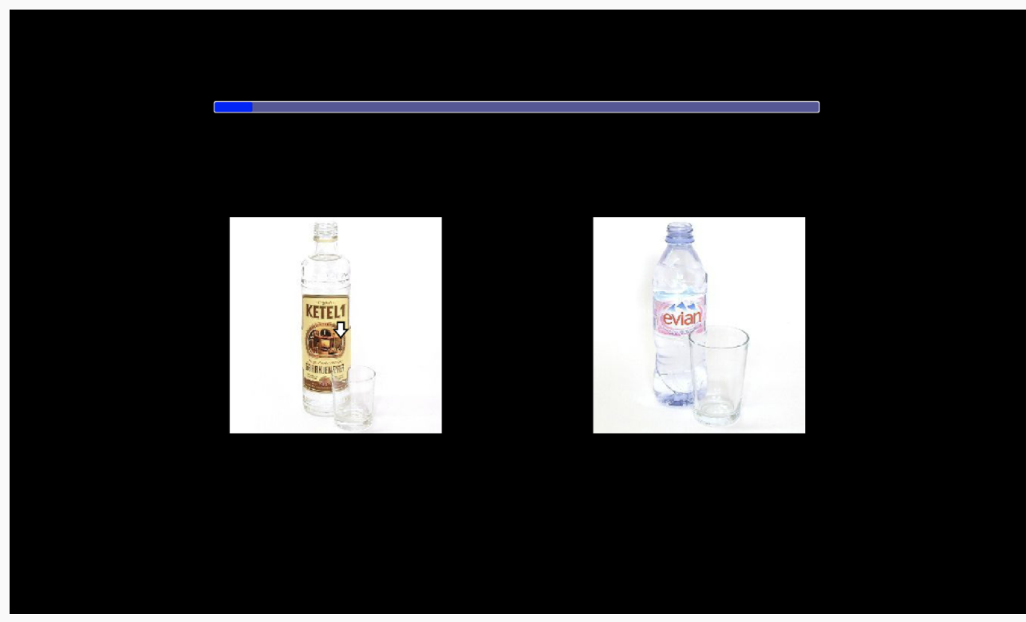
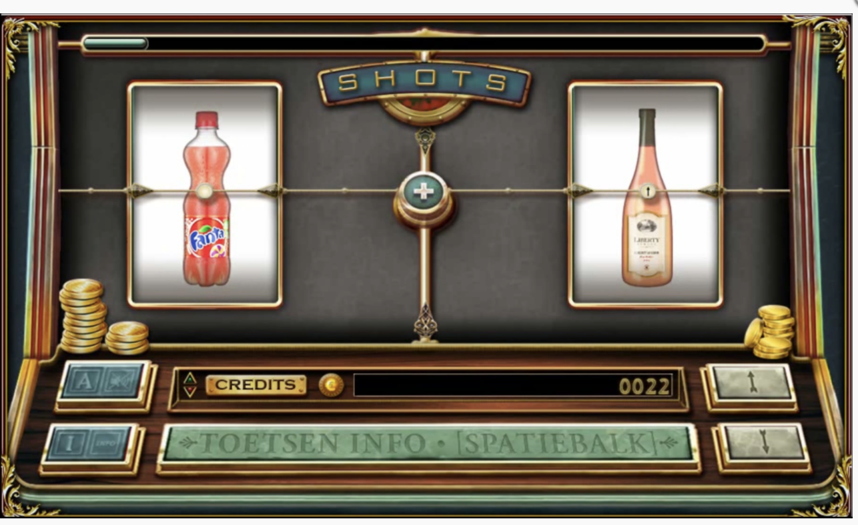
Meaningful Purpose
Good games use mechanics to amplify goals that are meaningful to the player
New Super Mario Bros. Wii (Nintendo, 2009)
SHOTS (Boendermaker et. al., 2016)
Notes:
Left: SHOTS: An alcohol gamification attempt gave users fake “gambling credits” that could not be used or spent on anything. The gamification does nothing to amplify the underlying purpose of the intervention. Study found that the SHOTS game version did not do enough to counteract the “tiresome nature of the training”
Right: Mario. Meaningful purpose through challenges, obstacles. Some motivation through narrative (save the princess). Points don’t motivate at all!!!!

Slide 18
Meaningful Purpose
Good games use mechanics to amplify goals that are meaningful to the player
Questions to consider:
Does the app present a purpose that is meaningful to the user.
Do the mechanics / features of the app enhance this purpose. Do they directly relate to the user’s primary purpose?
Notes:
Left: SHOTS: An alcohol gamification attempt gave users fake “gambling credits” that could not be used or spent on anything. The gamification does nothing to amplify the underlying purpose of the intervention. Study found that the SHOTS game version did not do enough to counteract the “tiresome nature of the training”
Right: Mario. Meaningful purpose through challenges, obstacles. Some motivation through narrative (save the princess). Points don’t motivate at all!!!!

Slide 19
Meaningful Choice
Good games give players agency over how they achieve their goals
Monster Manor (Kamel Boulos et. al., 2015)
Super Mario Bros. (Nintendo, 1985)
Notes:
Left: Monster Manor; No meaningful choice as users have to put in their glucose levels and then buy cosmetic rewards. No choice that relates back to original goal. However, it may be the case that the user’s goal is to collect all of the items from the store, in which case there may be motivational affordances here. It is arguable whether or not that is the behavior the designers are hoping for as it incentivizes gaming of the system (i.e., making up glucose levels to get the reward).
Right: Mario. MANY examples of small choices related to ultimate goal. In image, go low (risky but has powerup) or simply jump over.

Slide 20
Meaningful Choice
Good games give players agency over how they achieve their goals
Questions to consider:
Does the app allow the user to make decisions about how they reach the goal?
If so, how meaningful are these decisions? Is the correct choice obvious, or are there legitimate distinct paths to success?
Notes:
Left: SHOTS: An alcohol gamification attempt gave users fake “gambling credits” that could not be used or spent on anything. The gamification does nothing to amplify the underlying purpose of the intervention. Study found that the SHOTS game version did not do enough to counteract the “tiresome nature of the training”
Right: Mario. Meaningful purpose through challenges, obstacles. Some motivation through narrative (save the princess). Points don’t motivate at all!!!!

Slide 21
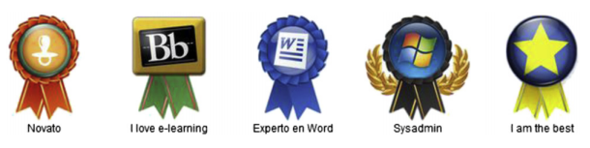
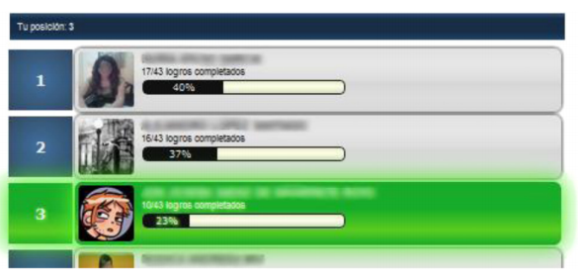
Supporting Player Archetypes
Good games implement mechanics that leverage individual player characteristics
(Dominguez et. al., 2012)
Minecraft (Markus Persson, 2009)
Notes:
Each of these slides will contain one entertainment game and one research gamification attempt. Most will feature a good example in the former category and poor example in the latter. This slide is one exception (both are good examples).
Left: Dominguez et al gamified an education system that promotes computer literacy skills. They added simple things like badges and social competition. The results showed that the experimental group did better on practical skills initially, but worse on higher level concepts and ultimately on the course final exam. The system
Right: Minecraft. Supports players who wish to build and explore socially. Achievements, badges, competition is all, at a minimum, secondary.

Slide 22
Supporting Player Archetypes
Good games implement mechanics that leverage individual player characteristics
Questions to consider:
Can players use the app “their way”?
Are their achievement based features (badges, achievements, etc.)
Are their social features?
Are their exploration based features?
Are there a mix of these types of features?
Notes:
Each of these slides will contain one entertainment game and one research gamification attempt. Most will feature a good example in the former category and poor example in the latter. This slide is one exception (both are good examples).
Left: Dominguez et al gamified an education system that promotes computer literacy skills. They added simple things like badges and social competition. The results showed that the experimental group did better on practical skills initially, but worse on higher level concepts and ultimately on the course final exam. The system
Right: Minecraft. Supports players who wish to build and explore socially. Achievements, badges, competition is all, at a minimum, secondary.

Slide 23
Feedback
Good games communicate precisely how player actions affect progress towards the goal
Dimension M (Tabula Digital, 2007)
Star Fox 64 (Nintendo, 1997)
Notes:
Right: Classic example of feedback in games involves bosses that flash brightly when the player is correctly damaging them. Unrealistic, sure, but makes clear to the player that their actions are helping move them towards their intended goals.
Left: Dimension M asks users to collect orbs (um ok), walk through electric wires and answer math problems to gain points. The game provides very little feedback regarding the direct connection between the actions the player takes and how those affect the purpose (to get better at math). In fact, in many ways this feedback undermines this purpose.

Slide 24
Feedback
Good games communicate precisely how player actions affect progress towards the goal
Questions to consider:
Does the app make it very clear how your actions are affecting your path towards the goal.
When you do things, is it obvious how much that helped? Do you know why?
Are you given enough feedback that you can plan your path to your goal somewhat effectively?
Notes:
Right: Classic example of feedback in games involves bosses that flash brightly when the player is correctly damaging them. Unrealistic, sure, but makes clear to the player that their actions are helping move them towards their intended goals.
Left: Dimension M asks users to collect orbs (um ok), walk through electric wires and answer math problems to gain points. The game provides very little feedback regarding the direct connection between the actions the player takes and how those affect the purpose (to get better at math). In fact, in many ways this feedback undermines this purpose.

Slide 25
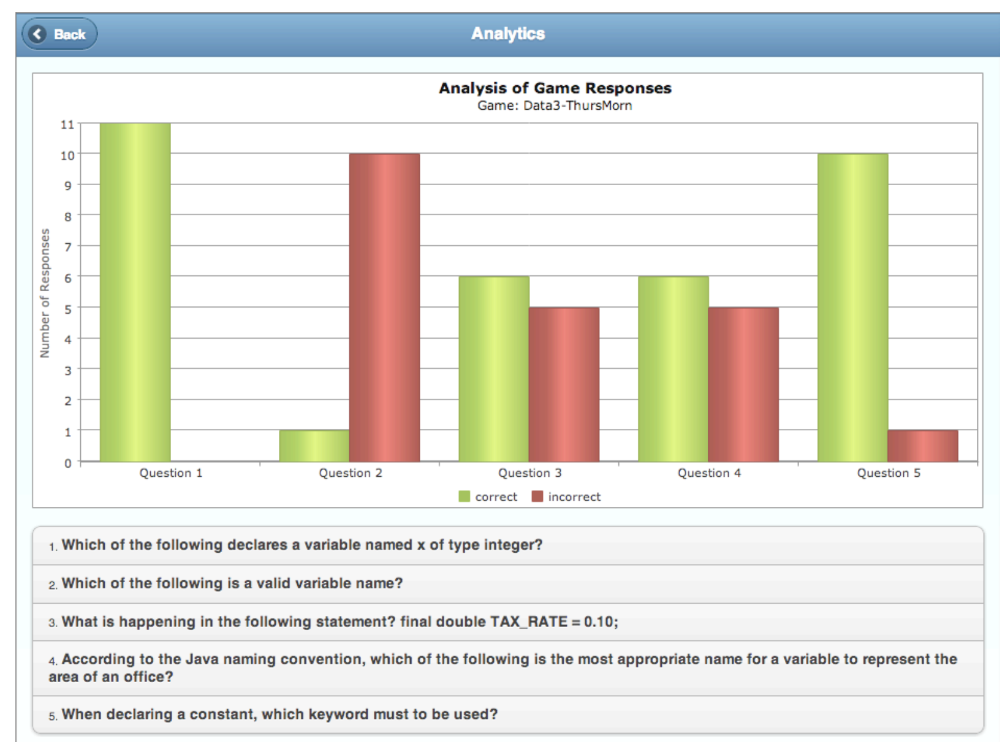
Visibility of Progress
Good games remind players how much progress has been made and how much more is needed
Final Fantasy X (Square Co., 2001)
Quiz Master (Cheong et. al., 2013)
Notes:
Right: Many games will show the user the progress they have made since beginning play in some way. FFX does this using the “sphere grid”, which shows precisely how many upgrades have been achieved and how many are left unfound. Note that some video games will hide this information from the player for one reason or another.
Left: Gamified quiz game “quiz master” attempts to be “fun” by invoking competition among students taking a quiz. However, it isn’t really gamification. The students never get to see progress across a single quiz or progress across quizzes, and are never shown where they are headed / what the final goal is. As a result, the results of the study were poor.

Slide 26
Visibility of Progress
Good games remind players how much progress has been made and how much more is needed
Questions to consider:
Does the app clearly provide access to a history of the user’s progress?
Is this progress clear and understandable?
Is this progress motivating?
Notes:
Right: Many games will show the user the progress they have made since beginning play in some way. FFX does this using the “sphere grid”, which shows precisely how many upgrades have been achieved and how many are left unfound. Note that some video games will hide this information from the player for one reason or another.
Left: Gamified quiz game “quiz master” attempts to be “fun” by invoking competition among students taking a quiz. However, it isn’t really gamification. The students never get to see progress across a single quiz or progress across quizzes, and are never shown where they are headed / what the final goal is. As a result, the results of the study were poor.

Slide 27
1: Define a Model
Supporting Player Archetypes
Meaningful Choice
Meaningful Purpose
Feedback
Visibility of Progress
*NOTE: We are not claiming these are exhaustive or complete. They are heuristics.
Notes:
Quickly discuss how we did a lit. review and came up with five gamification principles. Don’t discuss each of them yet, there is a slide for each coming up.

Slide 28
Homework: Perform the Evaluation
You will be given an assignment of mental health applications to study
Download the apps and use them every day for at least 10 minutes
Everybody will be doing more than one of these
I will provide an evaluation form
Describe whether or not the apps adhere to our heuristics
You MUST justify your answers. If you don’t we will throw it out and you will lose points
You MUST convince us that you actually used the app, otherwise we will throw the data out and you will lose points
Write a short (0.5 page) summary of the app and its primary usability problems.
Notes:
Quickly discuss how we did a lit. review and came up with five gamification principles. Don’t discuss each of them yet, there is a slide for each coming up.

Slide 29
Questions?
Notes:
Quickly discuss how we did a lit. review and came up with five gamification principles. Don’t discuss each of them yet, there is a slide for each coming up.

